Slide 1
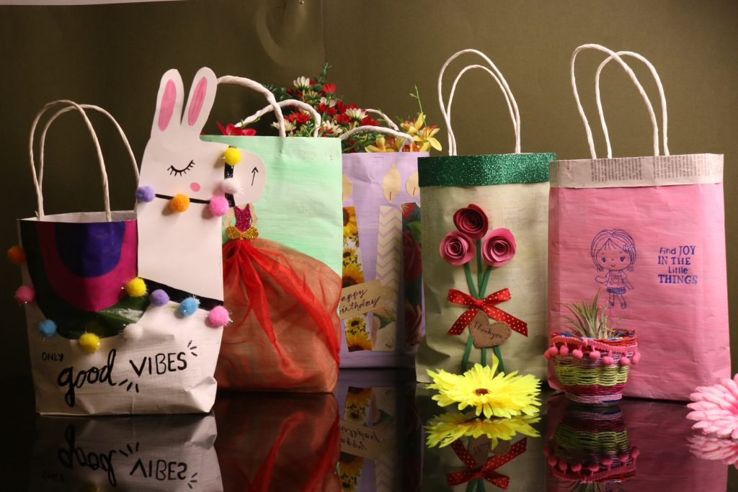
National Education Society’s
Ratnam College of Arts, Science & Commerce, Bhandup (W)
Department of Botany
Under DBT – Star Status Scheme
Workshop on
Paper Bag Making
5th February 2021, Friday at 1.00pm
by
Mr. Amol Chavan
Paper Artist
Organising committee
Dr. Sunita Chahar (HOD)
Ms. Shweta Belose
MS. Mamta Yadav
Link :

